Slide 1
Inter-thread communication
Inter-thread communication or Co-operation is all about allowing synchronized threads to communicate with each other.
Cooperation (Inter-thread communication) is a mechanism in which a thread is paused running in its critical section and another thread is allowed to enter (or lock) in the same critical section to be executed. It is implemented by following methods of Object class:
wait()
notify()
notifyAll()

Slide 2
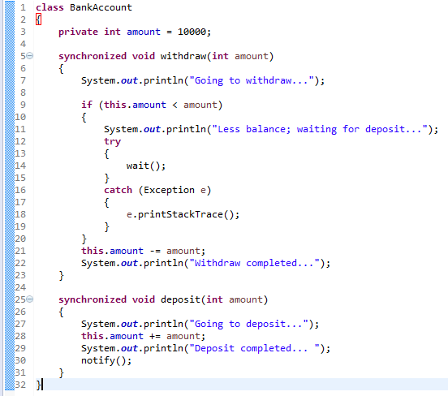
Inter-thread communication
T1 [withdraw]
T2 [Deposit]
T2 deposits 80000 and notify to T1 by calling notify() method.
T1 tries to withdraw 50000, but the amount in the bank account is
10000,So T1 will wait at 14th line [T1 waits for T2 to deposit more money in the bank account and notify the T1]
Once T1 get the notification from T2,T1 will complete the withdraw .

Slide 3
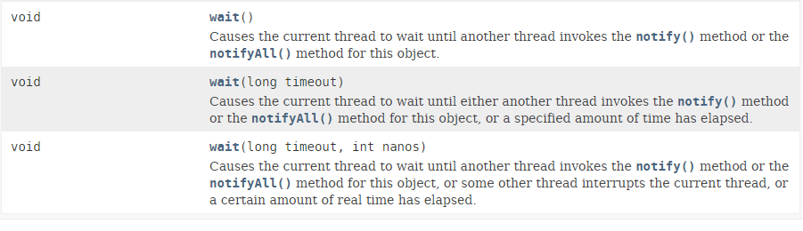

Inter-thread communication
Why wait(), notify() and notifyAll() methods are defined in Object class not Thread class?
It is because they are related to lock and object has a lock.

Slide 4
Inter-thread communication
https://docs.oracle.com/javase/8/docs/api/index.html?java/lang/Object.html

